Slide 1
Regression Analysis
Multiple Linear Regression
Nicoleta Serban, Ph.D.
Professor
School of Industrial and Systems Engineering
Statistical Inference:
Data Example

Slide 2

About This Lesson

Slide 3
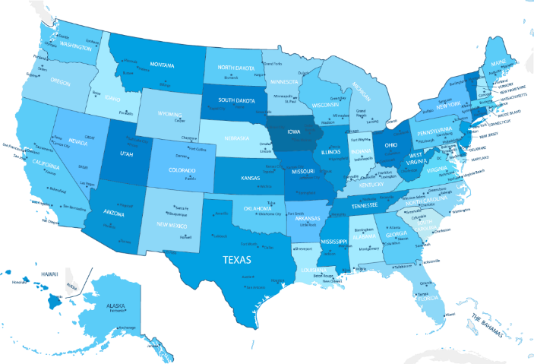
Linear Regression: Example 2
Controlling factors:
X₁ = % of total eligible students in the state who took the exam
X₆ = median percentile of ranking of test takers within their secondary school classes
Explanatory Factors:
X₂ = median income of families of test takers, in hundreds of dollars
X₃ = average number of years that test takers had in social sciences, natural sciences, and humanities
X₄ = % of test takers who attended public schools
X₅ = state expenditure on secondary schools, in hundreds of dollars per student

Slide 4
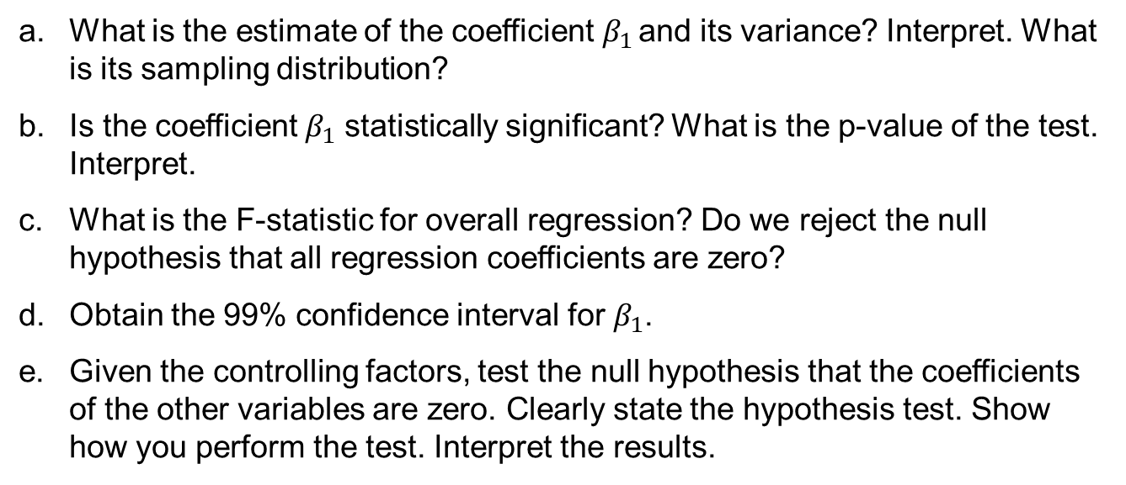
Example 2: Inference on Coefficients
What is the estimate of the coefficient $β_{1}$ and its variance? Interpret. What is its sampling distribution?
Is the coefficient $β_{1}$ statistically significant? What is the p-value of the test. Interpret.
What is the F-statistic for overall regression? Do we reject the null hypothesis that all regression coefficients are zero?
Obtain the 99% confidence interval for $β_{1}$.
Given the controlling factors, test the null hypothesis that the coefficients of the other variables are zero. Clearly state the hypothesis test. Show how you perform the test. Interpret the results.

Slide 5
Example 2: Inference on Coefficients
## Read the data using the 'read.table()' R command
data = read.table("SATData.txt", header = TRUE)
attach(data)
regression.line = lm(sat ~ takers + rank + income + years + public + expend)
summary(regression.line)
Coefficients:
---
Signif. codes: 0 ‘***’ 0.001 ‘**’ 0.01 ‘*’ 0.05 ‘.’ 0.1 ‘ ’ 1
Residual standard error: 26.34 on 43 degrees of freedom
Multiple R-squared: 0.8787, Adjusted R-squared: 0.8618
F-statistic: 51.91 on 6 and 43 DF, p-value: < 2.2e-16
 | Estimate | Std. Error | t value | Pr(>|t|)
(Intercept) | -94.659109 | 211.509584 | -0.448 | 0.656731
takers | -0.480080 | 0.693711 | -0.692 | 0.492628
rank | 8.476217 | 2.107807 | 4.021 | 0.000230 ***
income | -0.008195 | 0.152358 | -0.054 | 0.957353
years | 22.610082 | 6.314577 | 3.581 | 0.000866 ***
public | -0.464152 | 0.579104 | -0.802 | 0.427249
expend | 2.212005 | 0.845972 | 2.615 | 0.012263 *

Slide 6
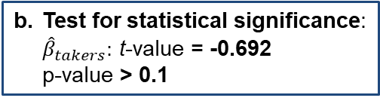
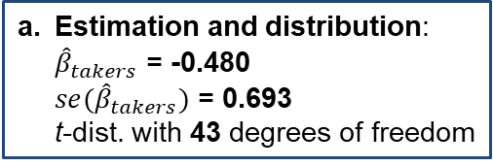
Example 2: Inference on Coefficients
## Read the data using the 'read.table()' R command
data = read.table("SATData.txt", header = TRUE)
attach(data)
regression.line = lm(sat ~ takers + rank + income + years + public + expend)
summary(regression.line)
Coefficients:
---
Signif. codes: 0 ‘***’ 0.001 ‘**’ 0.01 ‘*’ 0.05 ‘.’ 0.1 ‘ ’ 1
Residual standard error: 26.34 on 43 degrees of freedom
Multiple R-squared: 0.8787, Adjusted R-squared: 0.8618
F-statistic: 51.91 on 6 and 43 DF, p-value: < 2.2e-16
a. Estimation and distribution:
${\hat{β}}_{takers}$ = -0.480
${se(\hat{β}}_{takers})$ = 0.693
t-dist. with 43 degrees of freedom
 | Estimate | Std. Error | t value | Pr(>|t|)
(Intercept) | -94.659109 | 211.509584 | -0.448 | 0.656731
takers | -0.480080 | 0.693711 | -0.692 | 0.492628
rank | 8.476217 | 2.107807 | 4.021 | 0.000230 ***
income | -0.008195 | 0.152358 | -0.054 | 0.957353
years | 22.610082 | 6.314577 | 3.581 | 0.000866 ***
public | -0.464152 | 0.579104 | -0.802 | 0.427249
expend | 2.212005 | 0.845972 | 2.615 | 0.012263 *
b. Test for statistical significance:
${\hat{β}}_{takers}:$ t-value = -0.692
p-value > 0.1
c. Test for overall regression:
F-value = 51.91
p-value ≈ 0

Slide 7
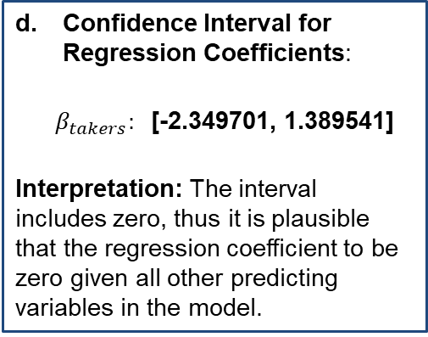
Example 2: Inference on Coefficients
confint(regression.line, "takers", level = 0.99)
0.5 % 99.5 %
takers -2.349701 1.389541
Confidence Interval for Regression Coefficients:
$β_{takers}:$[-2.349701, 1.389541]
Interpretation: The interval includes zero, thus it is plausible that the regression coefficient to be zero given all other predicting variables in the model.

Slide 8
Example 2: Inference on Coefficients
regression.line.reduced = lm(sat ~ takers + rank)
anova(regression.line.reduced, regression.line)
Analysis of Variance Table
Model 1: sat ~ takers + rank
Model 2: sat ~ takers + rank + income + years + public + expend
Res.Df RSS Df Sum of Sq F Pr(>F)
47 53778
43 29842 4 23935 8.6221 3.35e-05 ***

Slide 9

Example 2: Inference on Coefficients
regression.line.reduced = lm(sat ~ takers + rank)
anova(regression.line.reduced, regression.line)
Analysis of Variance Table
Model 1: sat ~ takers + rank
Model 2: sat ~ takers + rank + income + years + public + expend
Res.Df RSS Df Sum of Sq F Pr(>F)
47 53778
43 29842 4 23935 8.6221 3.35e-05 ***
Testing for a subset of regression coefficients:
$H_{0}:$ Reduced Model (takers and rank only) vs. $H_{A}:$ Full Model
Partial F Test:
F-value = 8.6221
P-value ≈ 0

Slide 10
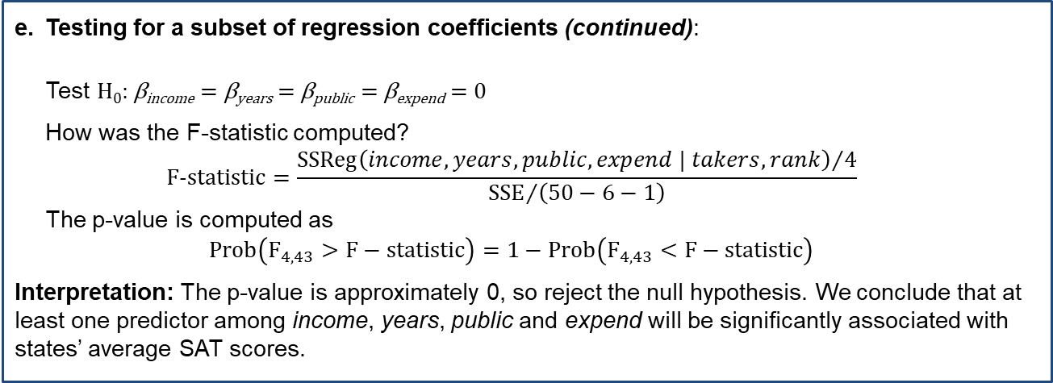
Example 2: Inference on Coefficients
Testing for a subset of regression coefficients (continued):
Test H₀: β_{income} = β_{years} = β_{public} = β_{expend} = 0
How was the F-statistic computed?
$$F‑statistic=\frac{{SSReg\left(income,years,public, expend | takers,rank\right)}/4}{{SSE}/{\left(50−6−1\right)}}$$
The p-value is computed as
$$Prob\left(F_{4,43}>F−statistic\right)=1−Prob\left(F_{4,43}<F−statistic\right)$$
Interpretation: The p-value is approximately 0, so reject the null hypothesis. We conclude that at least one predictor among income, years, public and expend will be significantly associated with states’ average SAT scores.

Slide 11

Summary

